Slide 1
Verifying Calibration for SunTech Vet20 BP Monitor

Slide 2
Calibration Basics
SunTech recommends checking the BP calibration every two years.
Units found to be out of calibration must be returned to SunTech for re-calibration.

Slide 3
Equipment Needed
Calibrated pressure reference
Analog Sphygmomanometer
Pressure vessel
500mL bottle or #6 or #7 cuff wrapped tightly around a solid object
Hand inflation bulb with bleed valve
T-Tube with connectors

Slide 4
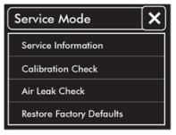
Step 1: Service Mode
Start with the device powered off.
Hold down the power button for approximately 6 seconds when turning the monitor on.
The Start/Stop button LED is white to indicate that the system is in service mode.

Slide 5
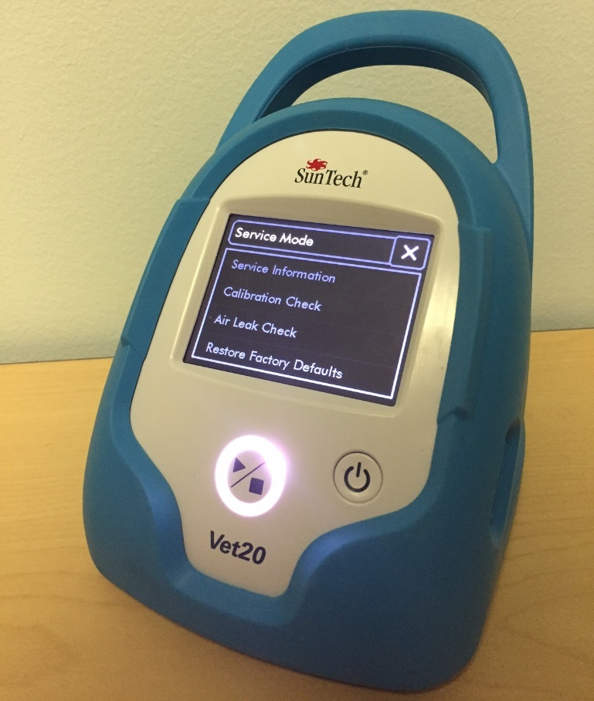
Step 1: Service Mode
Photo of Vet20 in service mode.

Slide 6
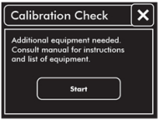
Step 2: System Setup
Touch “Calibration Check”.
Connect calibrated pressure reference, pressure vessel, and hand inflation bulb to the end of the monitor hose using T-tube and connectors.
Touch “Start”.
NOTE: Pressure vessel is optional and will not affect the accuracy of pressure readings, but it will make control of pressure settings easier if a pressure vessel is used.
NOTE: To easily make a pressure vessel, wrap a #6 or #7 SunTech BP cuff around a solid object (such as a cylindrical container or pipe section) that will limit cuff volume by exerting pressure as the cuff inflates.

Slide 7
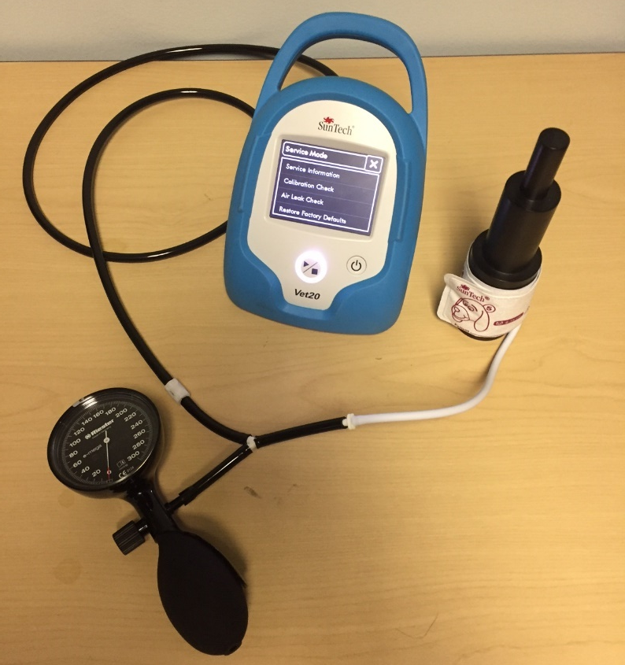
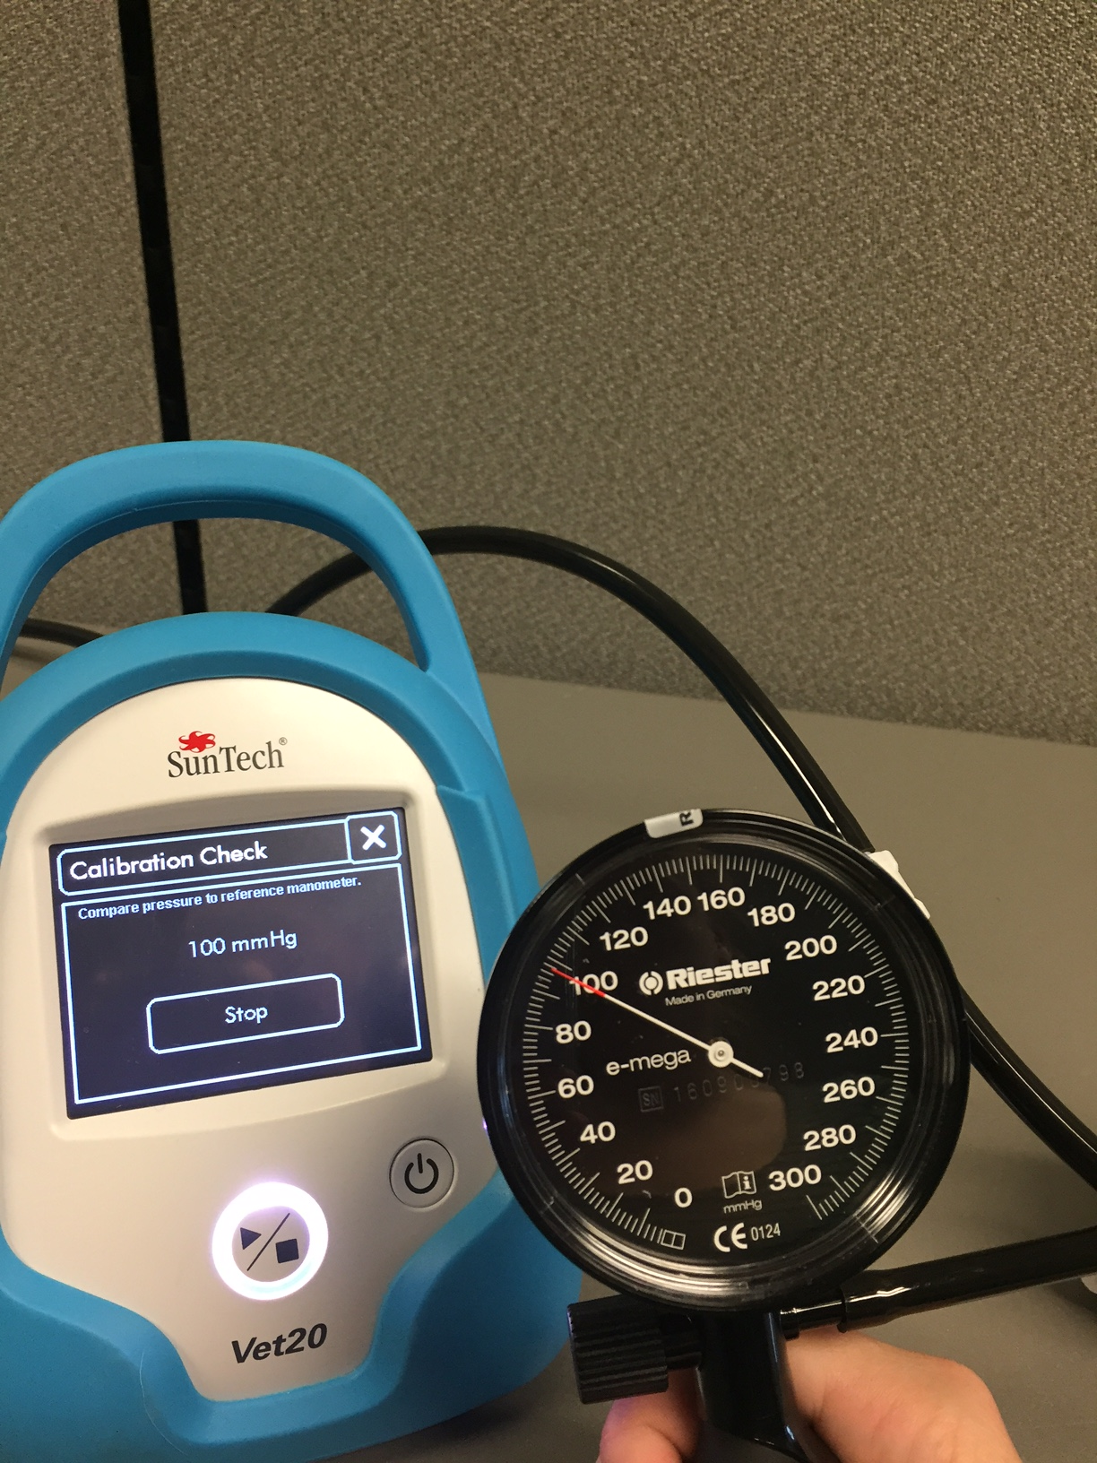
Step 2: System Setup
Cuff with
Pressure Vessel
T-Tubing
Reference Sphyg
Bulb w/bleed valve

Slide 8
Step 3: Compare Pressure Readings
Using the calibrated pressure device and bulb, check the readings on the SunTech Vet20 BP device against the value on the manometer according to the values shown in the table below.
Check Values (mmHg)
250
200
150
100
50
0

Slide 9
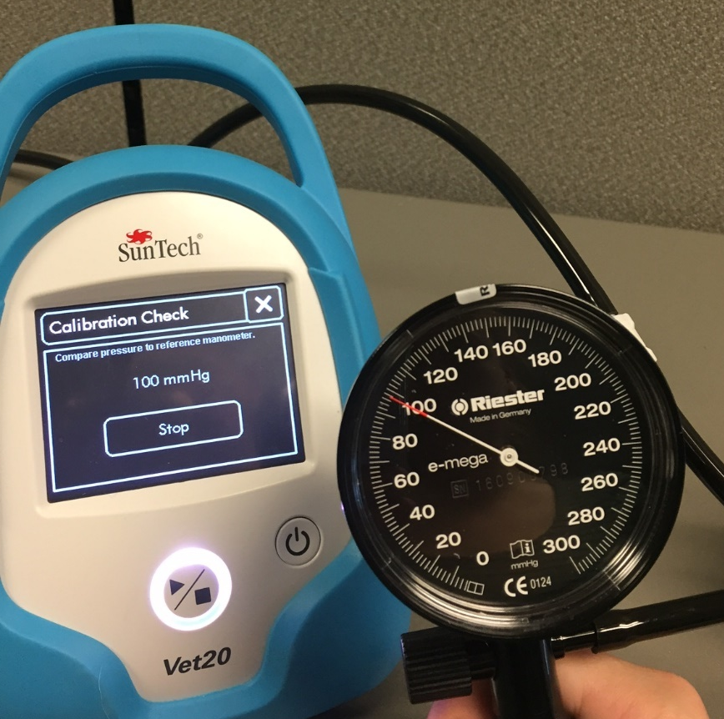
Step 3: Compare Pressure Readings

Slide 10
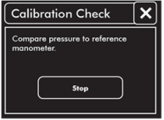
Step 3: Compare Pressure Readings
Verify that the monitor pressure is equal to the manometer pressure (*3 mmHg or 2% of the target value). If the pressure is within limits, then touch the “Stop” button and the calibration check is complete.
If not, the Vet20 BP monitor should be sent to SunTech for calibration.
Customer Technical Support Representatives can be reached, in the Americas, +1.800.421.8626 (US Toll Free) or 919.654.2300 from 8am to 5pm EST, Mon-Fri. In Europe, call +44 (0) 1865.884.234 from 9:00hrs to 17:00hrs GMT/UTC, Mon-Fri.
Customer Support can also be reached by email at: CustomerService@SunTechMed.com.
Repair & troubleshooting help can also be requested 24 hours a day via our web site, at: http://www.suntechmed.com/support/request-repair-and-troubleshooting-help

