Slide 1
Corporate Overview

Slide 2

Quality. Accuracy. Legacy.

Slide 3


Headquarters
Research Triangle Park, NC USA
EMEA Sales & Service
Oxfordshire, UK
Manufacturing, China Sales & Service Shenzhen, PRC
Asia Sales
Hong Kong
180 employees
R&D, Sales, Marketing, Finance in US
Dual production in USA and China
Service in US, UK, China, Japan

Slide 4

A Passion for measuring BP
Taking BP for over 30 years
Performance in difficult environments & patient populations
The Cauldwell Xtreme Everest Expedition utilized SunTech Medical non-invasive blood pressure systems in temperatures as low as -25⁰ Celsius at altitudes over 6400 meters.
Performing in Extremes

Slide 5

SunTech in Space
68 Missions
5,436 Orbits
225,855,334 KM Traveled
113,500 Hours and counting…

Slide 6
Company Timeline
SunTech acquires Central Blood Pressure technology from Centron Diagnostics.
SunTech establishes manufacturing plant in Shenzhen, China.
SunTech awarded U.S. patent 6,988,992 for Orbit ABPM cuff.
Space Shuttle Atlantis takes off with the first SunTech product to go into space.
NTG sells off a reorganized SunTech Medical Group (SMG).
SunTechnologies licenses Ambulatory Blood Pressure technology from UNC Chapel Hill.
2017
2014
2013
2008
2007
2006
2002
2000
1995
SunTech acquires CAS Medical’s OEM Blood Pressure products.
1989
1987
SunTech Medical acquired by Halma plc.
1983
SunTech’s first participation in Expedition Everest research.
Newport Technology Group (NTG) acquires SunTechnologies.
^{SunTech Accutracker II}
^{used in orbit on the}
^{115-day Mir-18 mission.}
SunTech moves to current offices in Morrisville, NC, USA.
SunTech opens office in Oxfordshire, UK.

Slide 7
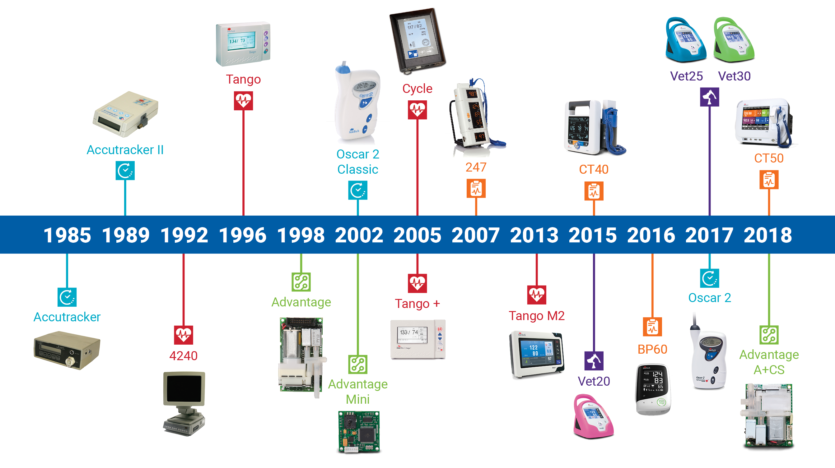
Products

Slide 8





Slide 9






ABPM
  Cardiology
  General Practice
  Clinical Research
BP+Vitals
  General practice
  Long term care
BP Cuffs
  Hospitals
  Med/Surg
  OEM
OEM NIBP
  Med device mfg
  Telemedicine
  Veterinary
Stress BP
  Exercise / Cardiac Stress Testing
Vet BP
  Veterinary Practice

Slide 10
24 Hour Ambulatory Blood Pressure Monitoring
Walk. Talk. Measure.

Slide 11
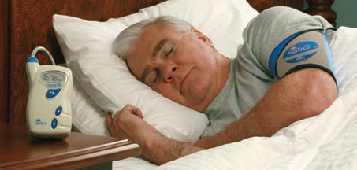
24 Hour Ambulatory Blood Pressure Monitoring
Oscar 2: Motion tolerance & clinical accuracy
Orbit Cuff: Patented design specifically for long term wear
AccuWin Pro: Interpretive analysis and reporting software
World’s leading manufacturer of ABP with multiple private label brands

Slide 12
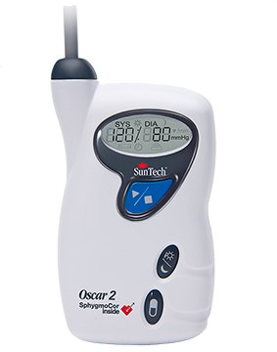
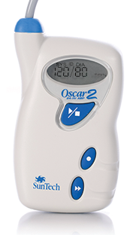
ABPM at SunTech
SunTech Oscar 2
Available with SphygmoCor
SunTech Oscar 2 Classic

Slide 13
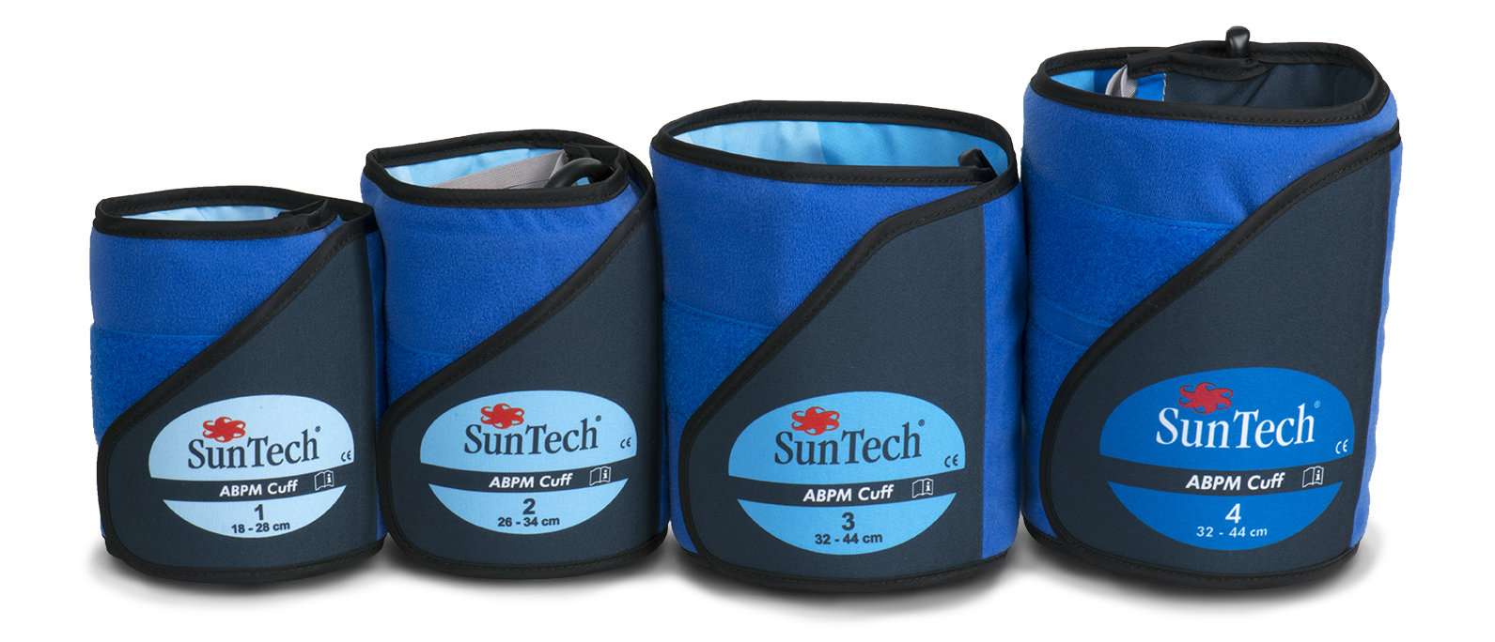
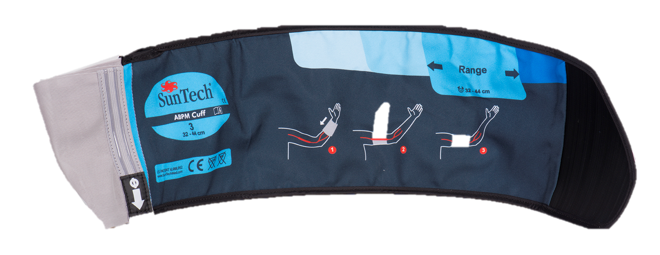
ABPM at SunTech
SunTech Orbit Cuffs

Slide 14
Professional BP plus Vitals
From A to BP

Slide 15
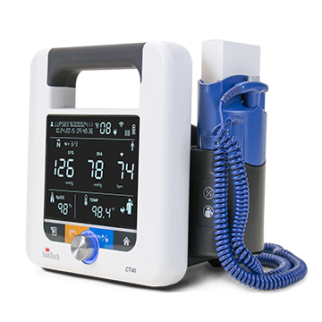
SunTech CT40
Automated Averaging and Manual Blood Pressure Measurement
Options
Temperature
SpO₂
Barcode Scanner
Printer
WiFi
Mobile Stand

Slide 16
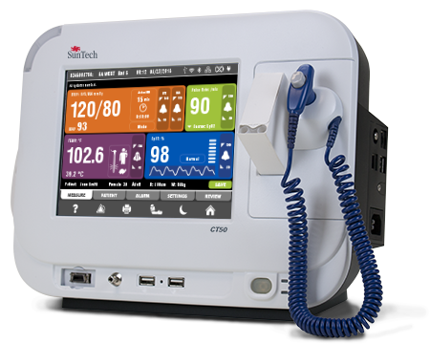
SunTech CT50
Automated BP Averaging and HL7 messaging, Masimo SET pulse oximetry, Covidien Filac 3000 temperature
Options
Barcode Scanner
Thermal Printer
WiFi
Mobile Stand

Slide 17
Blood Pressure Cuffs
We’ve Got You Covered

Slide 18
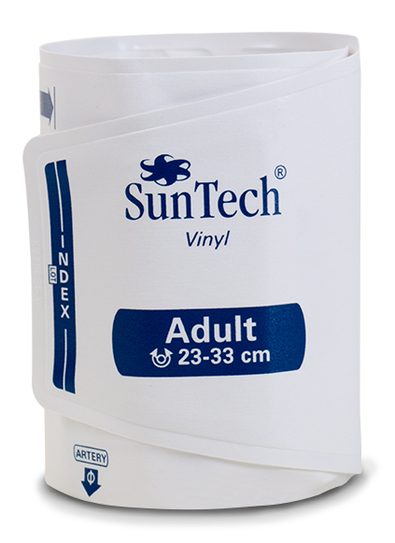
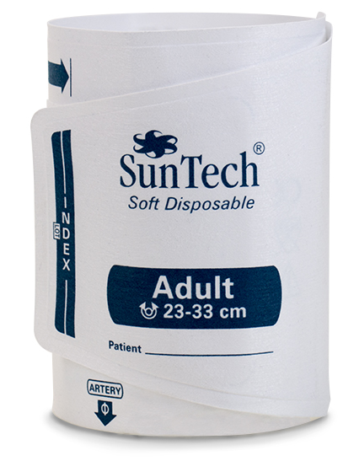
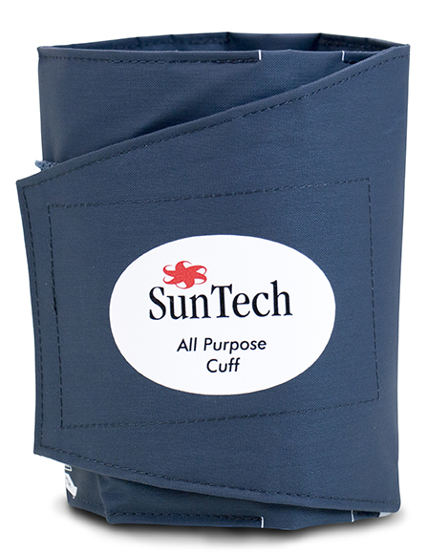
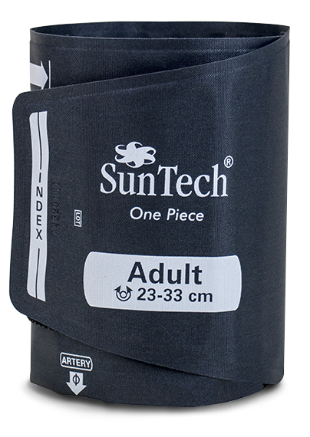
Blood Pressure Cuffs
All Purpose
Durable BP Cuff
One Piece
Durable BP Cuff
Vinyl
Short-term Use BP Cuff
Soft Disposable
Single Patient Use BP Cuff
Disposable and Vinyl cuffs engineered to meet infection control and comfort needs
Single and Two-Piece Durable cuff designs
Cuff & Connector Standardization Program

Slide 19
OEM Blood Pressure Technology
Our Technology. Your Solution.

Slide 20
Answer these questions and you’ll be on your way to a blood pressure monitoring system that’s tailor made to match your specific needs.
1
What’s your clinical environment?
Patient Monitoring
Emergency Transport
Hemodialysis
Kiosk Health Station
Veterinary
Custom Applications
3
Which of these features best match your top priorities?
Price
Power Efficiency
Physical Size
Severity of Environement
Customization
Other Priorities
2
In what countries will you sell this device?
4
We have your SunTech OEM NIBP Solution

Slide 21
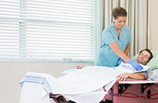



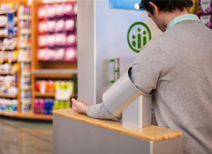
Typical Clinical Situations
Standard Clinical Advantage SMT | EMS Advantage TMT & RMT | Hemodialysis Advantage HDM | Veterinary Advantage VET | Kiosk Advantage KSK

Slide 22
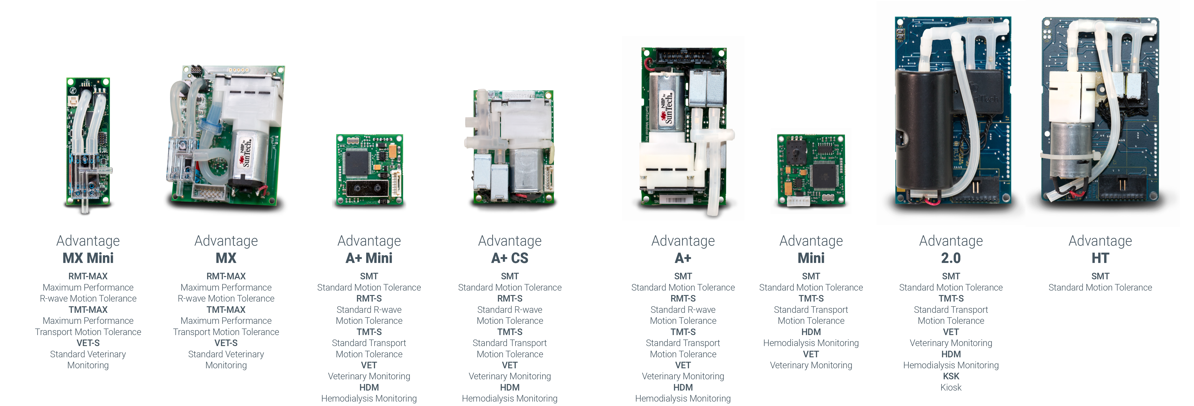
The SunTech Advantage

Slide 23
Cardiac Stress Test Blood Pressure
Don’t Miss a Beat

Slide 24
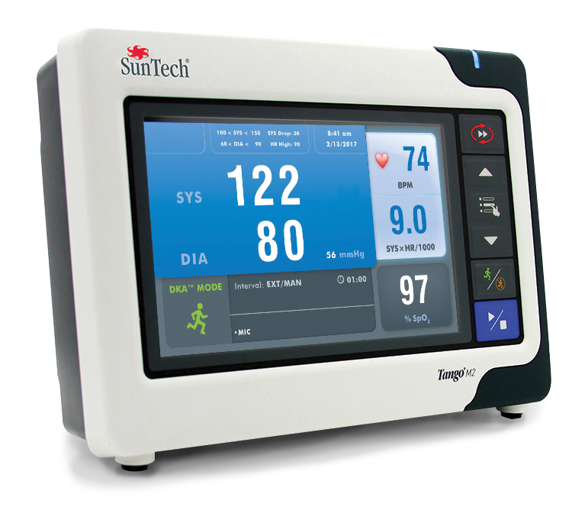
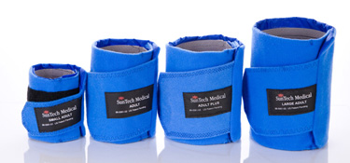
Cardiac Stress Test Blood Pressure
Tango M2: Automated, Hands-free Blood Pressure Measurement
Orbit-K cuff: Patented design maintains proper placement
Proprietary DKA technology acquires accurate BP in high noise and motion environments

Slide 25
Veterinary Blood Pressure
Better BP for Pets and Vets

Slide 26
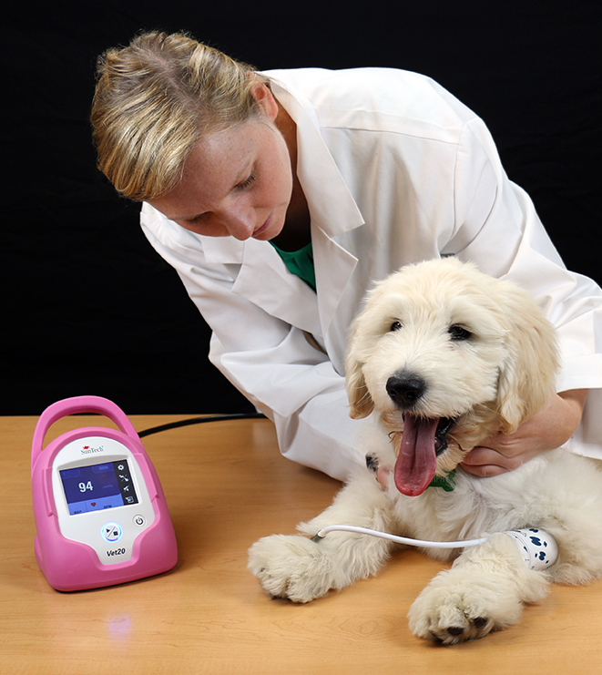
SunTech Vet BP
  Accurate: BP algorithm specifically developed for companion animals by experts at a leading vet school.
Fast: Measurements take less than 1 minute. Doppler takes 10 minutes.
  Quiet: Device quietly measures BP and alarms can be silenced to avoid frightening the animal.
  Portable: Small, battery-operated device easily carried to another exam room.

Slide 27
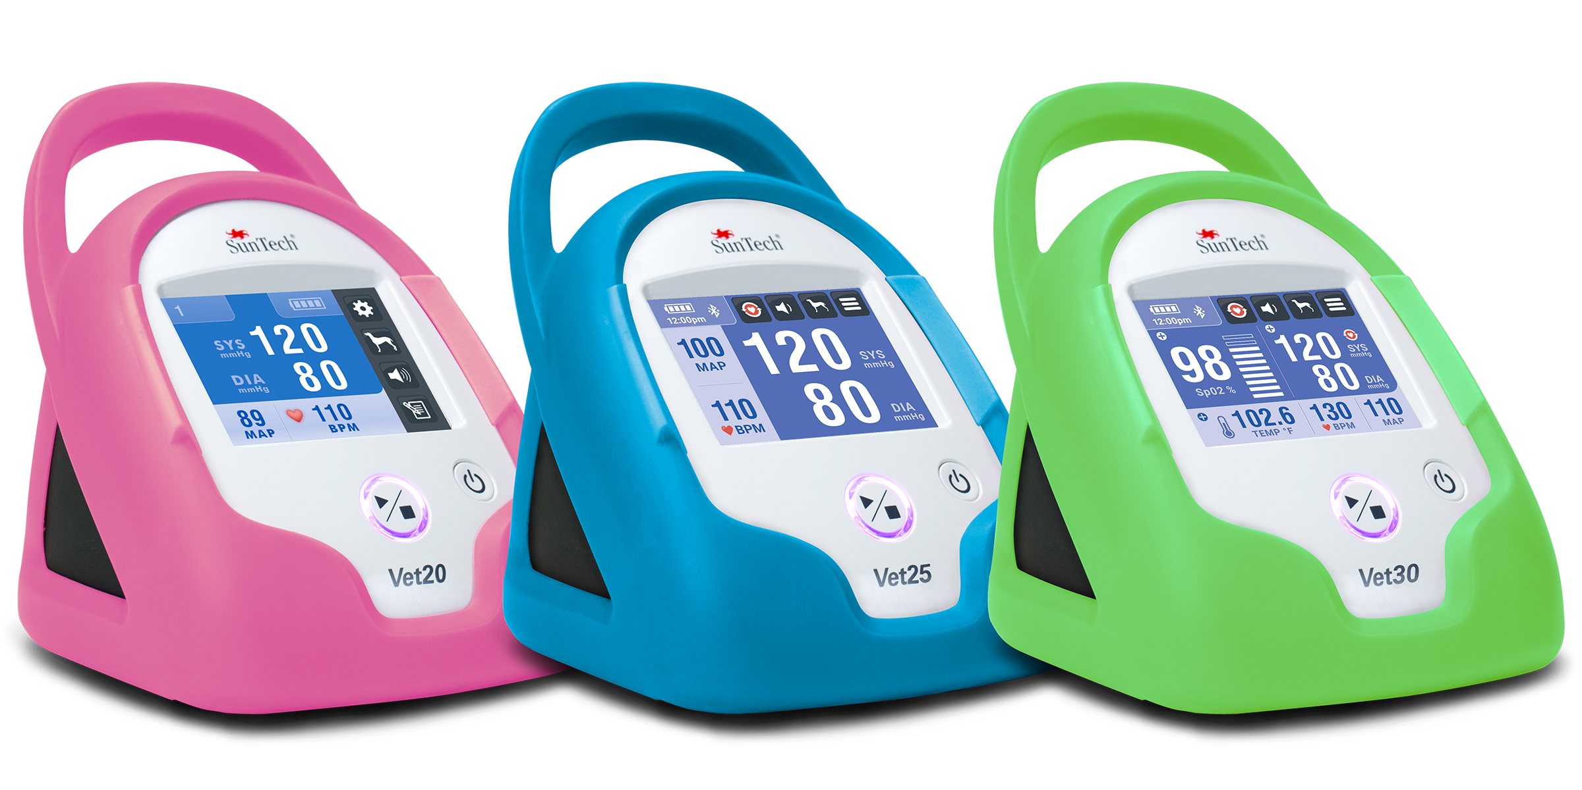
SunTech Vet BP
  Vet20: SunTech’s original veterinary monitor is the simplest way to get a BP on an awake cat or dog.
  Vet25: Designed to be flexible – for measuring BP in the exam room or operating room
  Vet30: Combines trusted SunTech BP technology with oxygen saturation and temperature monitoring for animals pre-, post-, or during a procedure.

Slide 28

Learn more about SunTech Medical
Website: suntechmed.com
Product information & brochures
Demonstration videos
White papers
User manuals
Blog @ SunTech: blog.suntechmed.com
Resource & discussion place for blood pressure measurement
Customer / end-user feedback and comments
Hypertension news of interest
Medical device industry trends

Slide 29



Connect with SunTech Medical
SunTech Medical
@SunTechMed
@SunTechVetBP
SunTech Vet BP

Slide 30
Thank You

